Slide 1
Chapter 3
Software Development Life Cycle

Slide 2
Review
A development process consists of various phases, each phase ending with a defined output.
The phases are performed in an order specified by the process model being followed.
The software development process goes through several phases:
  Requirement Specifications
  Analysis
  Design
  Implementation
  Testing
  Conversion
A process is a particular method of doing something, generally involving a number of steps or operations.
The Software development process consists of the following processes:
  Development Processes
  Project Management Processes
  Software Configuration Management (SCM) Processes
  Process Management Processes
  Software Engineering Principles / Chapter 3 / <number> of 27

Slide 3
Objectives
Compare how software development companies organize their development process
Explain the essentials of any process models
Discuss the advantages and disadvantages of various process models
Describe the criteria for choosing the appropriate process models
Describe the process model for the Web and the process technology
  Software Engineering Principles / Chapter 3 / <number> of 27

Slide 4
Essentials of any Process Model
Requirements Definition
Requirements Analysis
Preliminary Design
Detailed Design
Implementation
System Testing
Maintenance and Operation
  Software Engineering Principles / Chapter 3 / <number> of 27

Slide 5
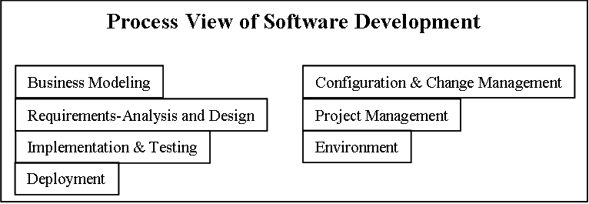
Software Development
A Process View
  Software Engineering Principles / Chapter 3 / <number> of 27

Slide 6
Process Models
Linear Process Models
  Waterfall Model
  Prototyping Model
Evolutionary Software Process Models
  Incremental Model
  Spiral Model
  Component Assembly Model
  Software Engineering Principles / Chapter 3 / <number> of 27

Slide 7
Waterfall Model
Suggests a systematic, sequential approach to software development
Phases
  System/ Information engineering and modeling
  Software requirements analysis
  Software Design
  Detailed Design
  Coding
  Testing
  Integration
  Operations and Maintenance
  Software Engineering Principles / Chapter 3 / <number> of 27

Slide 8
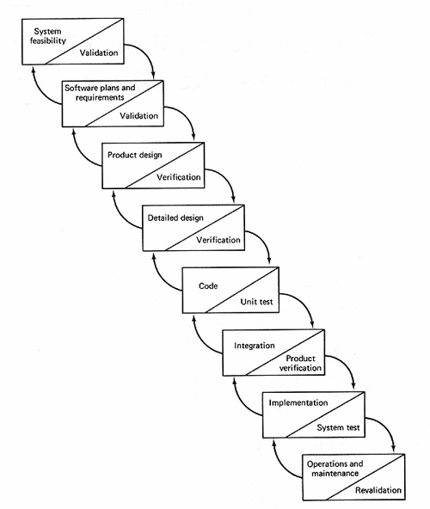
Waterfall Model Contd…
  Software Engineering Principles / Chapter 3 / <number> of 27

Slide 9
Waterfall Model - Shortfalls
Real projects rarely follow the sequential flow that the model proposes
Often difficult for the customer to state all requirements explicitly
Customer must have patience
  Software Engineering Principles / Chapter 3 / <number> of 27

Slide 10
Prototyping Model
Allows for reduced functionality or limited performance version of the eventual software
Delivered in the early stage of project lifecycle
Helps to make the user requirement more concrete
  Software Engineering Principles / Chapter 3 / <number> of 27

Slide 11
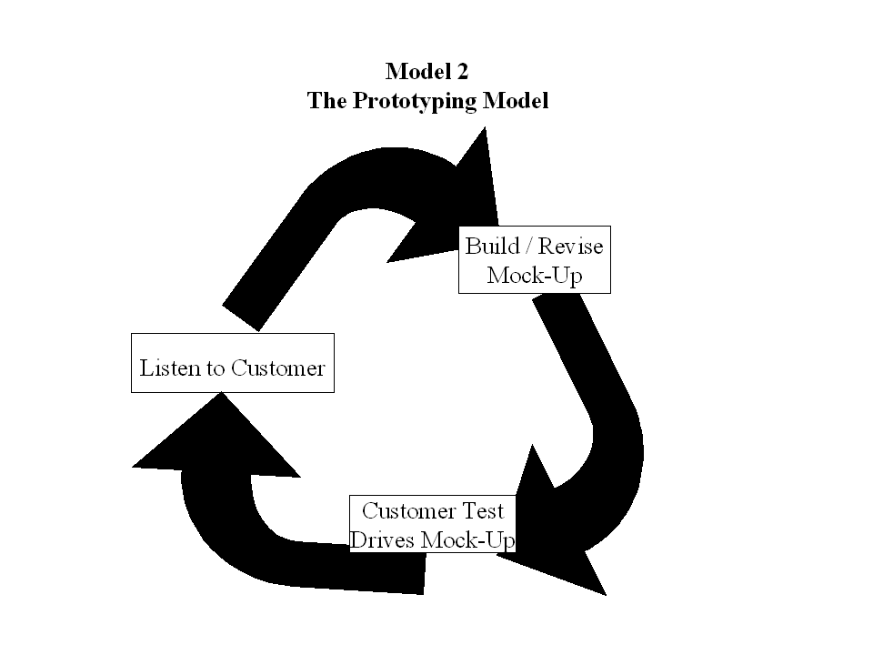
Prototyping Model Contd…
  Software Engineering Principles / Chapter 3 / <number> of 27

Slide 12
Incremental Model
Combines
  Elements of the linear sequential model
  Iterative philosophy of prototyping
  Software Engineering Principles / Chapter 3 / <number> of 27

Slide 13
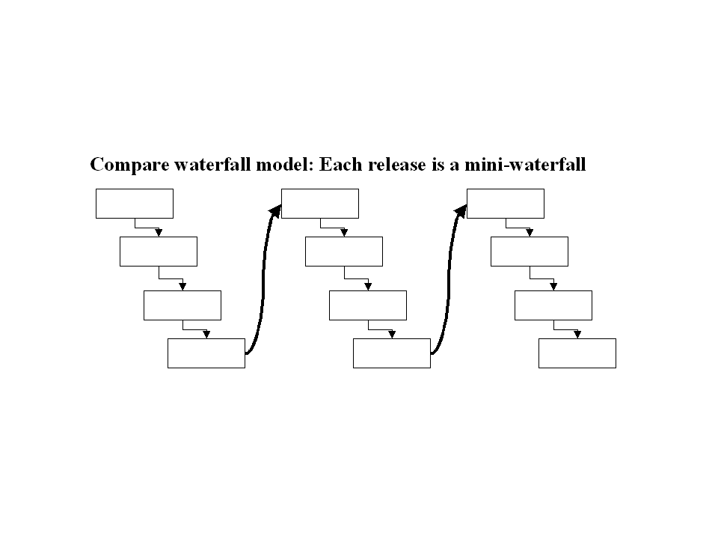
Incremental Model Contd…
  Software Engineering Principles / Chapter 3 / <number> of 27

Slide 14
Incremental Model –
Benefits
Tolerates changing requirements
Elements are integrated progressively
Risks are mitigated earlier
Allows the organization to learn and improve
Facilitates reuse
Results in a more robust product
Process itself can be improved and refined along the way
Accommodates changes
  Software Engineering Principles / Chapter 3 / <number> of 27

Slide 15
Incremental Model –
Benefits Contd…
Provides a way in which management can perform tactical changes to the product
Allows technological changes on the way
Increasing reuse
Easier to take advantage of commercial-off-the-shelf (COTS) products
Learning
Higher quality
Results in a more thoroughly tested product
  Software Engineering Principles / Chapter 3 / <number> of 27

Slide 16
Incremental Model – Problems
Inflexible point-solutions
High-risk downstream capabilities
Off-target initial release
  Software Engineering Principles / Chapter 3 / <number> of 27

Slide 17
Spiral Model
Views software development as a spiral process
Divided into framework activities, called, task regions
  Understanding the Context
  Planning-tasks
  Risk analysis-tasks
  Engineering-tasks
  Construction & release
  Customer Evaluation-tasks
Task regions vary from 3 to 6
  Software Engineering Principles / Chapter 3 / <number> of 27

Slide 18
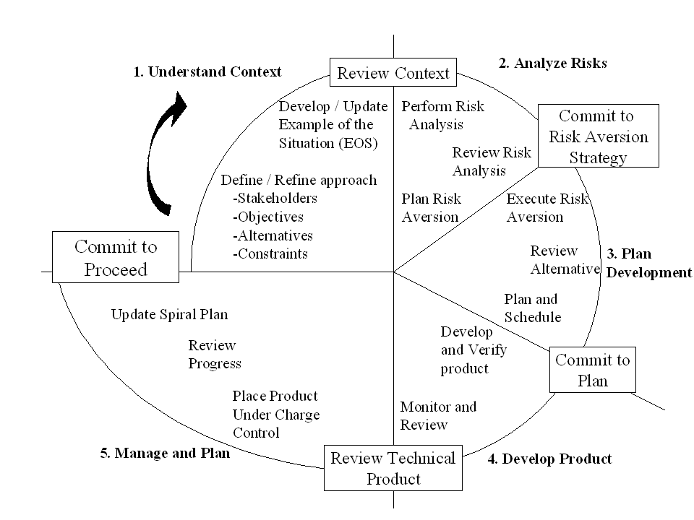
Spiral Model Contd…
  Software Engineering Principles / Chapter 3 / <number> of 27

Slide 19
Spiral Model – Explanation
Inner cycles represent the early phases of requirement analysis along with prototyping
Outer spirals are progressively representative of the classic software life cycle
  Software Engineering Principles / Chapter 3 / <number> of 27

Slide 20
Component Assembly Model
Application is built from discrete executable components
Application may be upgraded in smaller increments
Components may be shared between applications
  Software Engineering Principles / Chapter 3 / <number> of 27

Slide 21
Choosing a Process Model – The Criteria
Time frame available
Execution of project
Type of product/project being developed
Detail in which specifications are available
Having previous experience with similar projects
  Software Engineering Principles / Chapter 3 / <number> of 27

Slide 22
Process Tailoring
The process of adjusting the standard process of an organization
Obtains a process that is suitable for the particular business or technical needs of a project
Happens at
  Macro Level
  Micro level
  Software Engineering Principles / Chapter 3 / <number> of 27

Slide 23
Process Tailoring-Criteria
Scope
Formality
Frequency
Granularity
  Software Engineering Principles / Chapter 3 / <number> of 27

Slide 24
Process Tailoring-
Influencing Factors
Skill level of the team
Peak team size
Criticality of the application
  Software Engineering Principles / Chapter 3 / <number> of 27

Slide 25
Web Engineering
An adaptable and incremental process
Populated by a set of framework activities
  Formulation
  Planning
  Analysis
  Modeling
  Page generation and testing
  Customer evaluation
  Software Engineering Principles / Chapter 3 / <number> of 27

Slide 26
Process Technology Tools
Help software organizations
  Analyze their current process
  Organize work tasks
  Control and monitor progress
  Manage technical quality
Example - Rational Unified Process
  Implements incremental approach
Allow a software organization to build an automated model of
  Common process framework
  Task sets
  Umbrella activities
  Software Engineering Principles / Chapter 3 / <number> of 27

Slide 27
Summary
Software engineering is a discipline that integrates process, methods, and tools for the development of computer software.
A number of different process models for software engineering have been proposed, each exhibiting strengths and weaknesses, but all having a series of generic phases in common.
Any process model goes through:
  Requirements definition
  Requirement analysis
  Preliminary design
  Detailed design
  Coding
  Testing
  Integration
  Operations and maintenance
The software process models can be broadly categorized into Linear process models and Evolutionary software process models.
  Software Engineering Principles / Chapter 3 / <number> of 27

